Slide 1
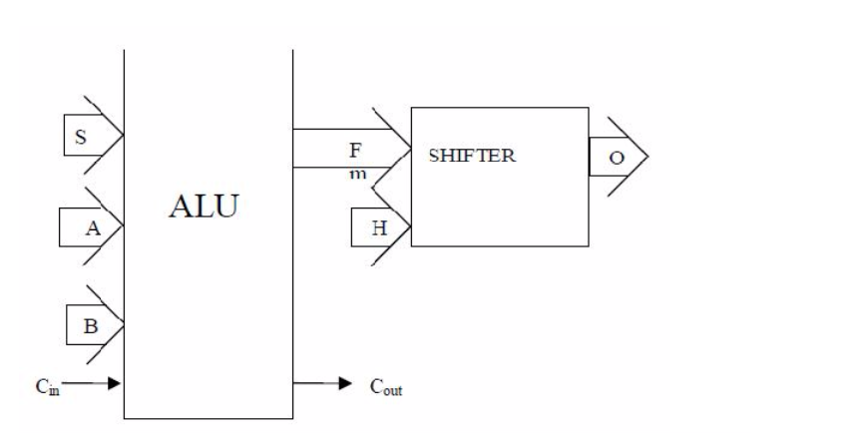
4bit Arithmetic logic Unit(ALU) and a Shifter unit.

Slide 2
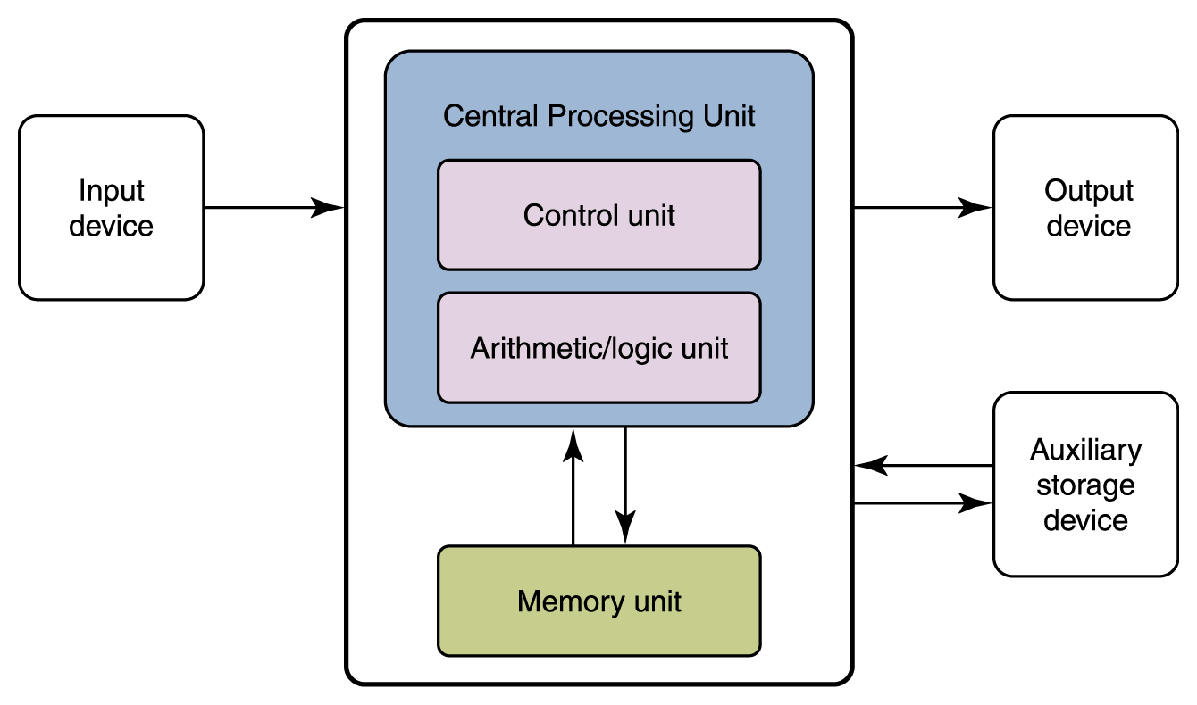
Importance of ALU
The arithmetic/logic unit (ALU): Performs mathematical and logical operations.

Slide 3
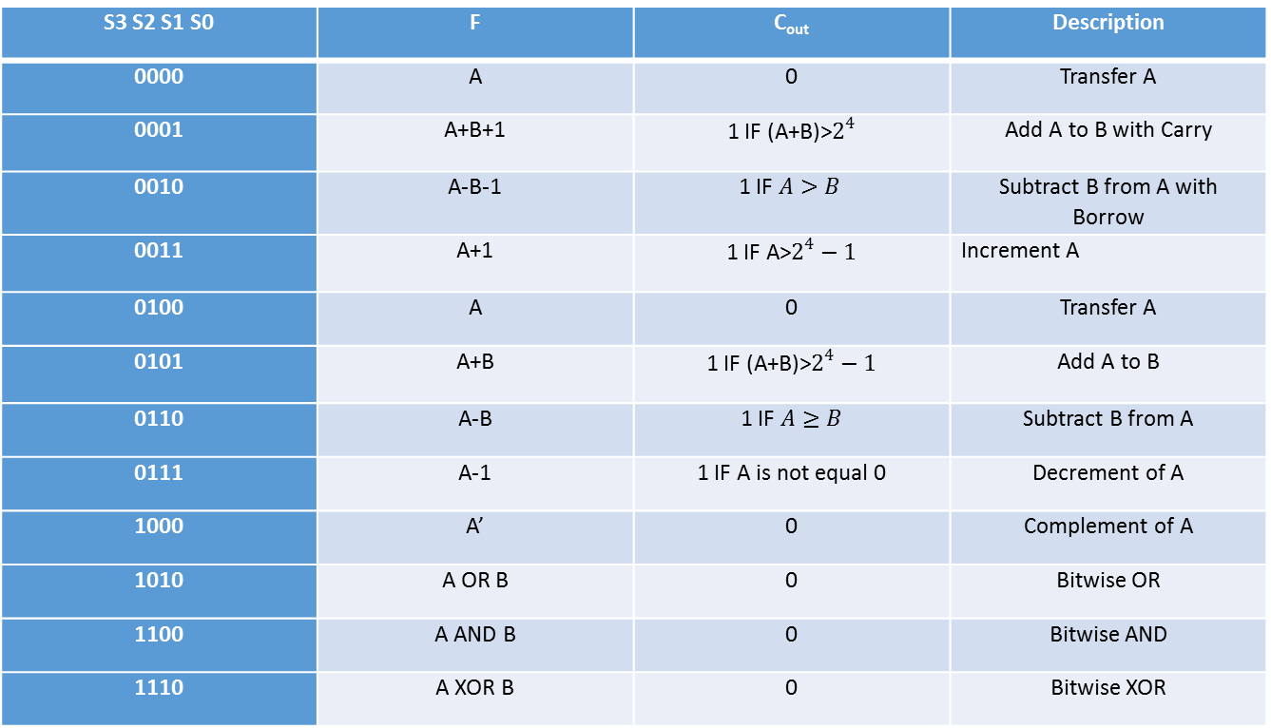
Problem Statement:
S3 S2 S1 S0 | F | C_{out} | Description
0000 | A | 0 | Transfer A
0001 | A+B+1 | 1 IF (A+B)>$2^{4}$ | Add A to B with Carry
0010 | A-B-1 | 1 IF $A>B$ | Subtract B from A with Borrow
0011 | A+1 | 1 IF A>$2^{4}−1$ | Increment A
0100 | A | 0 | Transfer A
0101 | A+B | 1 IF (A+B)>$2^{4}−1$ | Add A to B
0110 | A-B | 1 IF $A≥B$ | Subtract B from A
0111 | A-1 | 1 IF A is not equal 0 | Decrement of A
1000 | A’ | 0 | Complement of A
1010 | A OR B | 0 | Bitwise OR
1100 | A AND B | 0 | Bitwise AND
1110 | A XOR B | 0 | Bitwise XOR

Slide 4
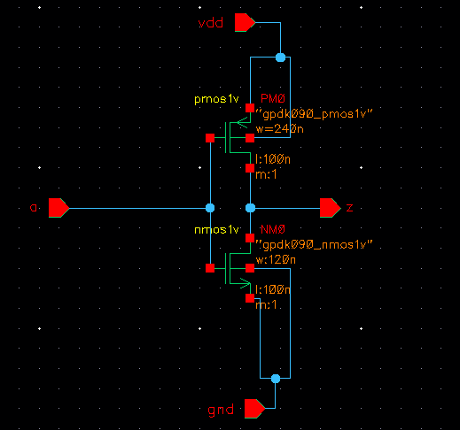
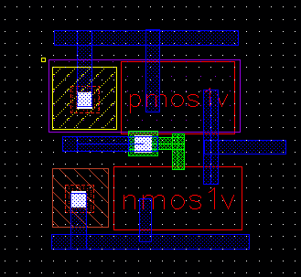
CMOS NOT Gate

Slide 5
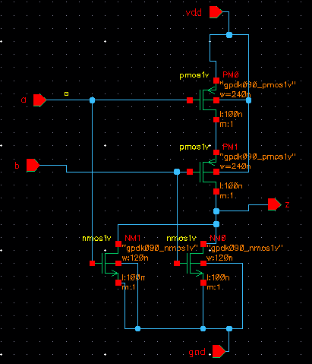
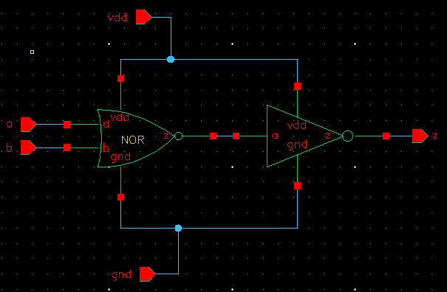
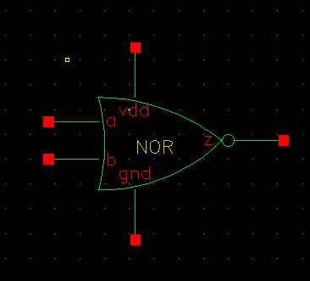
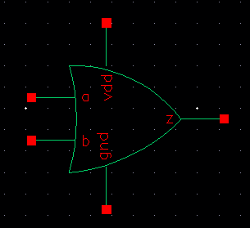
OR Gate

Slide 6
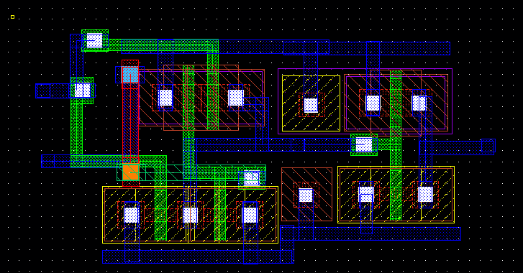
Layout of CMOS OR Gate
Size: 3.5x2.07 (umxum)

Slide 7
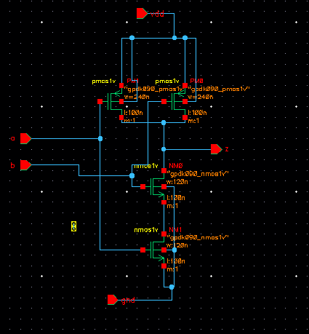
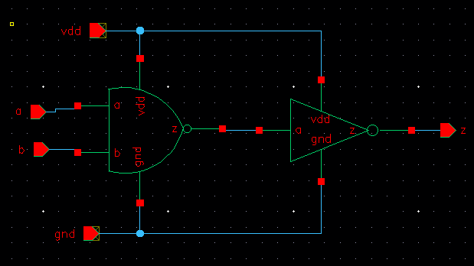
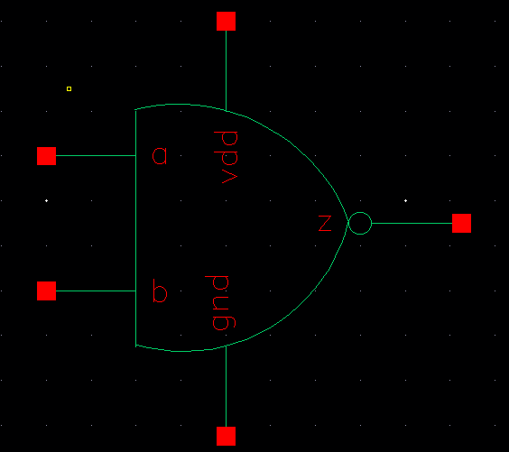
CMOS AND Gate

Slide 8
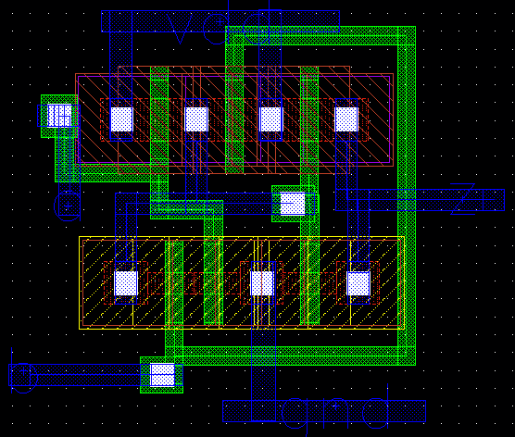
Layout of AND Gate

Slide 9
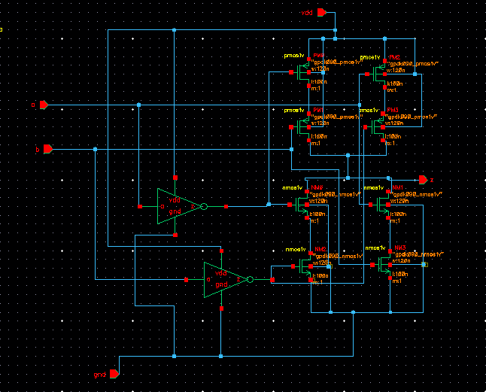
XOR Gate

Slide 10
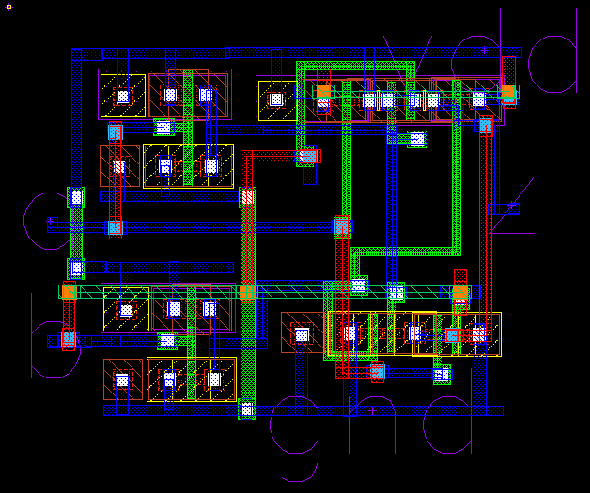
Layout for XOR gate

Slide 11
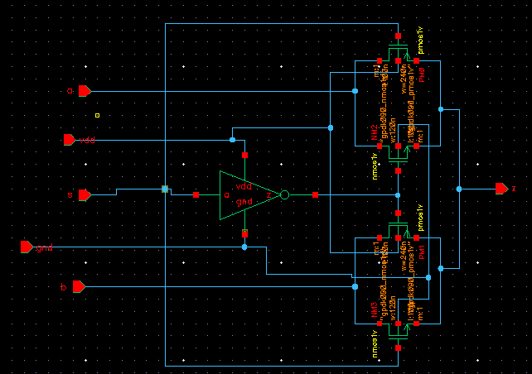
2-1 MUX

Slide 12
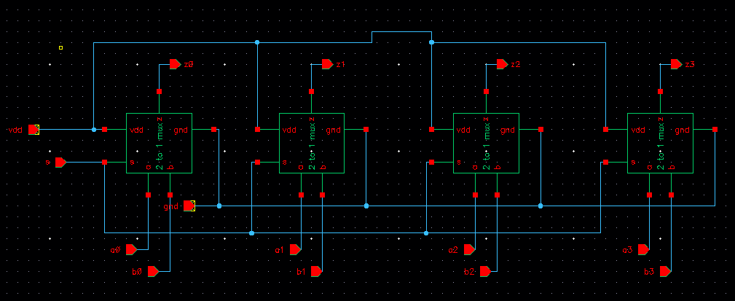
Quad 2-1 MUX

Slide 13
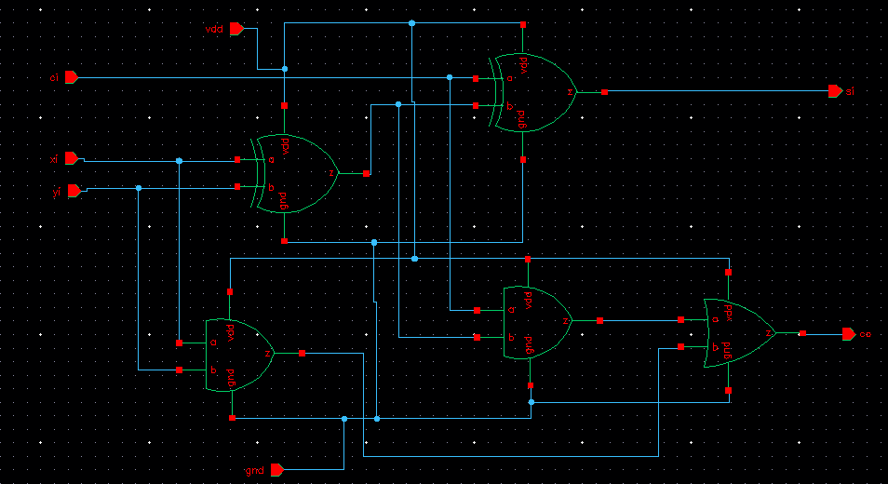
1-bit full adder

Slide 14
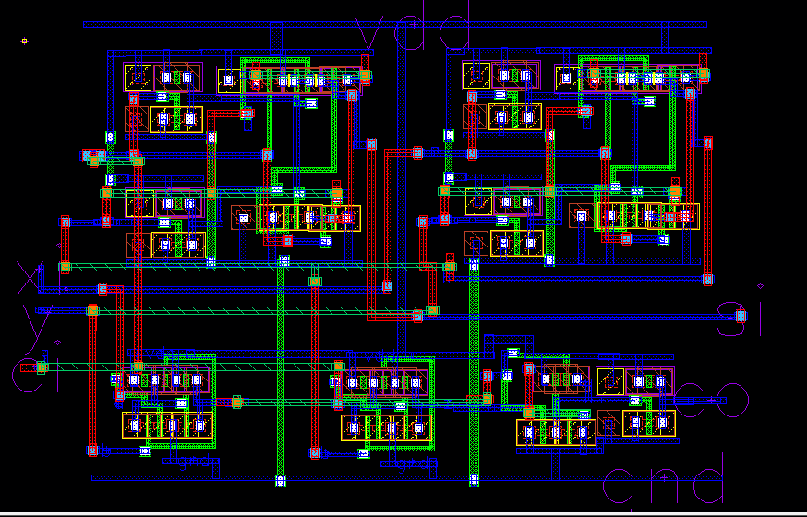
Layout for 1 bit full adder
Size: 13.7x9 (umxum)

Slide 15
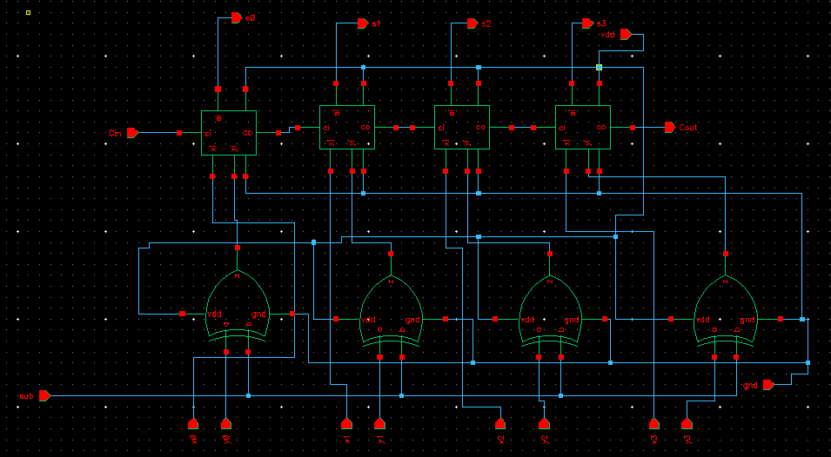
4 bit ripple carry adder

Slide 16
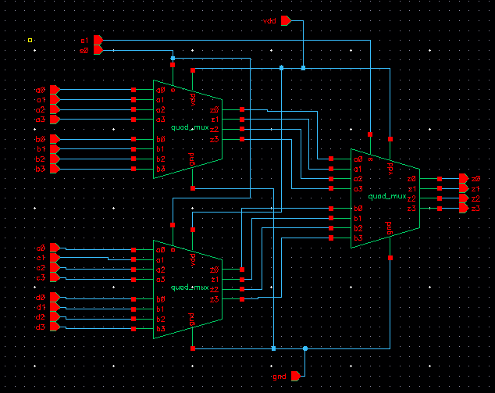
16-4 MUX

Slide 17
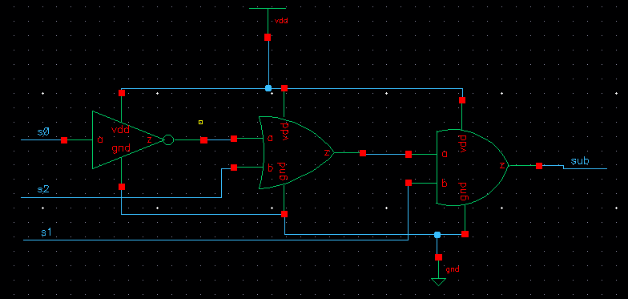
Adder/ Subtract decoder

Slide 18
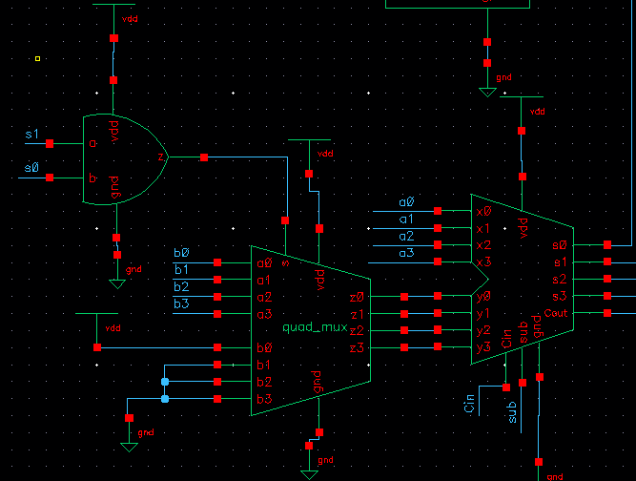
Increment/Decrement function Selection:

Slide 19
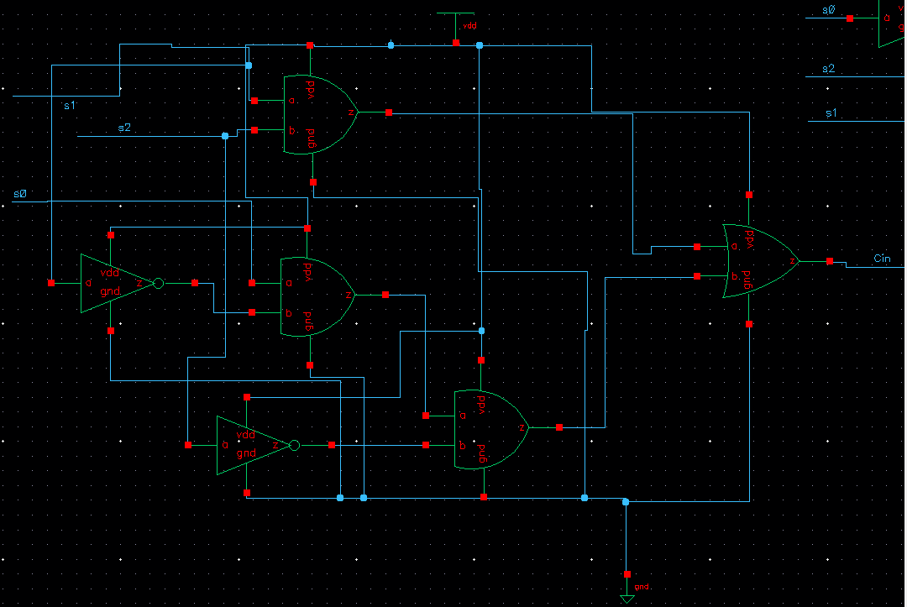
Carry In Function decoder

Slide 20
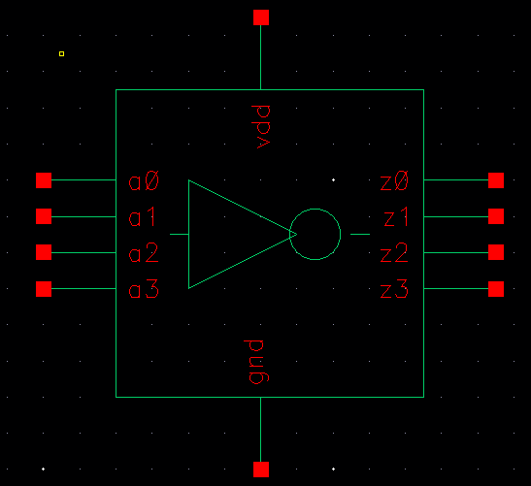
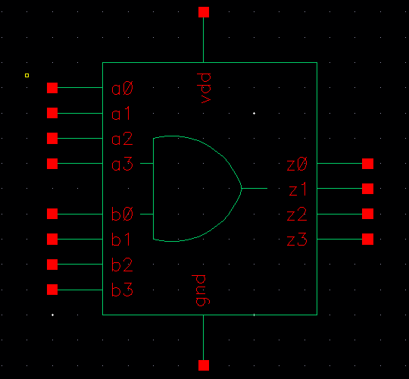
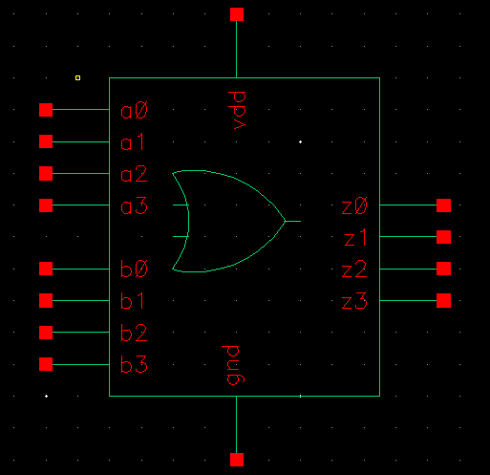
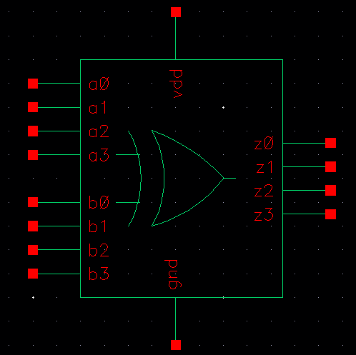
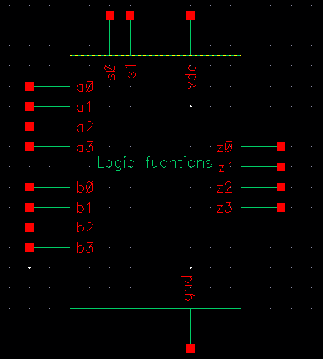
16 to 4 MUX

Slide 21
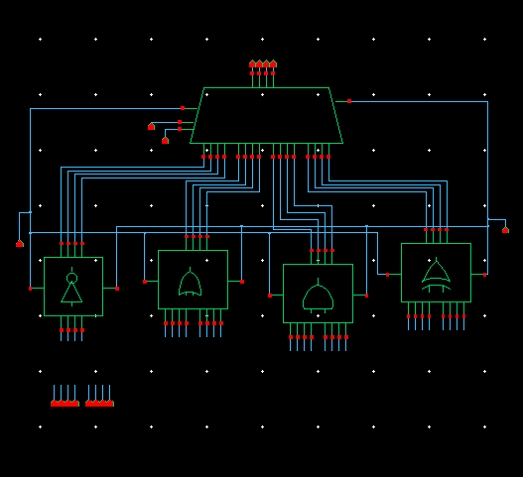
Logic Functions

Slide 22
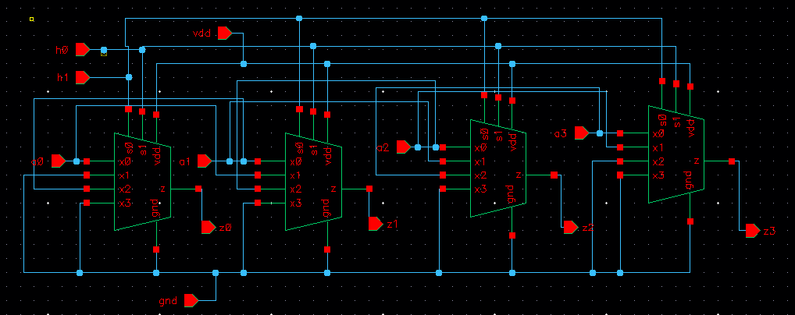
Shifter

Slide 23
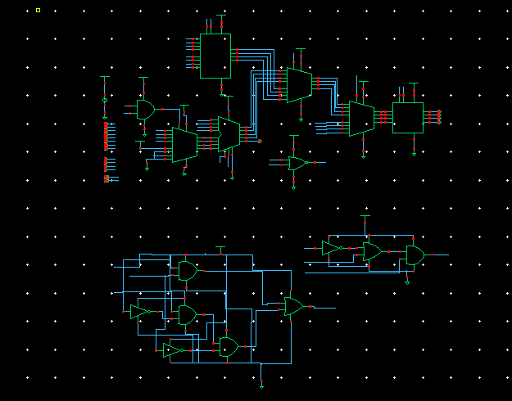
ALU with Shifter

Slide 24
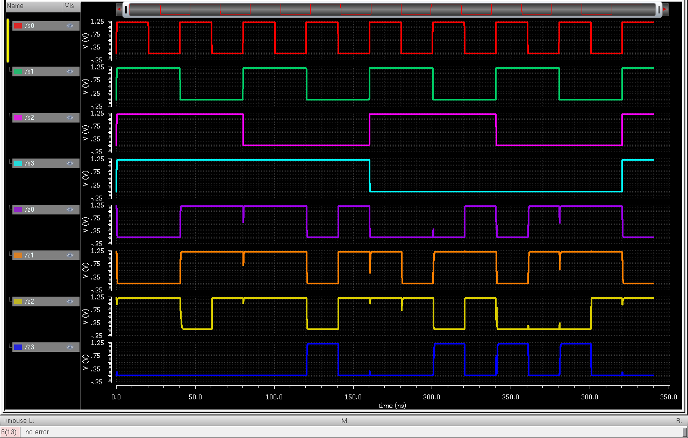
No shift: A=0111, B=0011, h0=0,h1=0

Slide 25
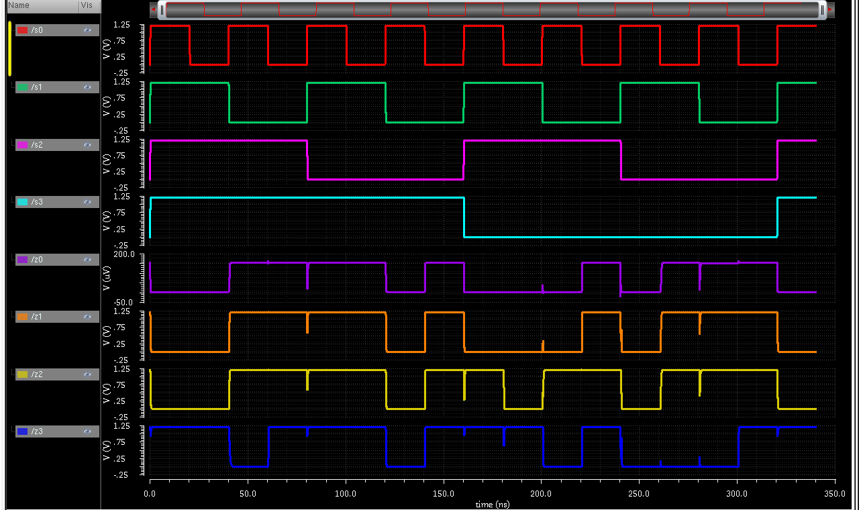
Left Shift A=0111, B=0011, h0=0,h1=1

Slide 26
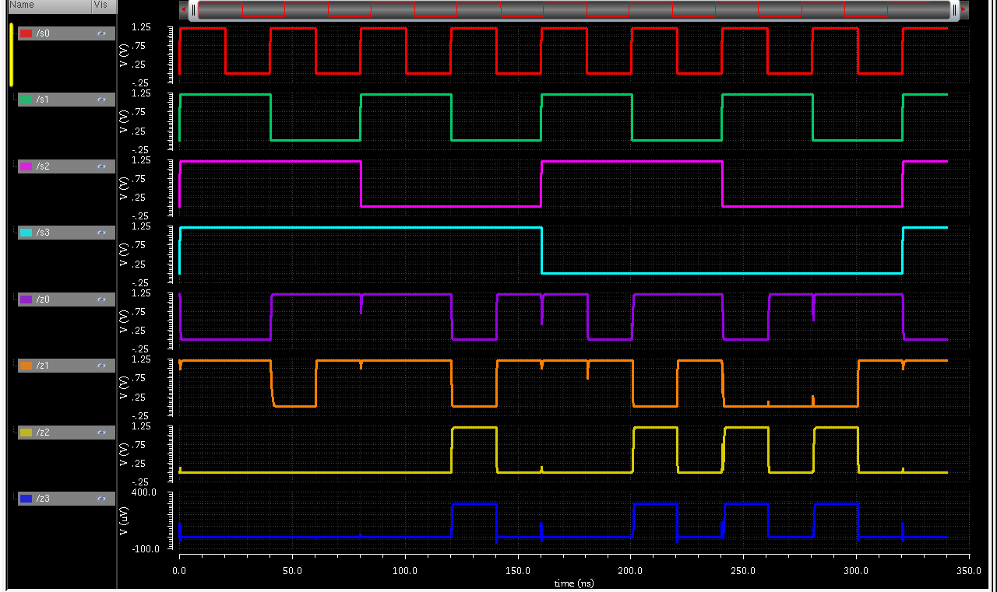
Right Shift A=0111, B=0011, h0=1,h1=0

Slide 27
Number of MOSFETs in the different Components
Name of the Elements | No of MOSFETs
Inverter | 2
NOR | 4
OR | 6
AND | 6
XOR | 12
2 to 1 MUX | 6
4 to 1 MUX | 18
Quad 2 to 1 MUX | 24
1 bit Full adder | 42
4 bit ripple carry adder | 216
Adder/subtract Selector | 14
Increment/Decrement Selector | 6
Carry In Selector | 28
4 bit Logic gates | 104
16 to 4 MUX | 72
Logic Functions | 176
Transfer function Selector | 14
Shifter | 72

Slide 28
Total MOSFETs required for “ALU with Shifter” Design
Name of the components | No of components |  | No of MOSFET
Logic Function | 1 |  | 176
Quad 2 to 1 MUX | 3 |  | 24x3
4 bit ripple carry adder | 1 |  | 216
Shifter | 1 |  | 72
Carry In Selector | 1 |  | 28
Adder/subtract Selector | 1 |  | 14
Transfer function Selector | 1 |  | 14
Increment/Decrement Selector | 1 |  | 6
Total No of MOSFET |  |  | 598

Slide 29
Thank You All
Any Question??

